Slide 1
Data Visualization
Programming for Data Analysis (CT127-3-2-PFDA and Version VC1)

Slide 2
Topic & Structure of the lesson
Data Visualization
ggplot2 package
Line and path plots
Bar chart
Histogram
Frequency Polygon
Box plot
Scatter plot
Count plot
Using colors and shapes in plots
Axis and plot labels
Facetting

Slide 3
Learning outcomes
At the end of this topic, you should be able to:
Understand how to use ggplot2 package for data visualization.

Slide 4
Key terms you must be able to use
If you have mastered this topic, you should be able to use the following terms correctly in your assignments and exams:
Data visualization
ggplot2 package
Line and path plots
Bar chart
Histogram
Frequency Polygons
Box plot
Scatter plot
Count plot
Using colors and shapes in plots
Axis and plot labels
Facetting

Slide 5
1
Data Visualization using ggplot2 package

Slide 6
Data Visualization
Data visualization is the graphic representation of data.
Graphics are used in statistics primarily for two reasons: exploratory data analysis (EDA) and presenting results.
The ggplot2 package is widely used to perform data visualization in R.
To install ggplot2: install.packages(“ggplot2”)
To load ggplot2: library(ggplot2)

Slide 7
ggplot2 package
Unlike most other graphics packages, ggplot2 has a deep underlying grammar.
This grammar is made up of a set of independent components that can be composed in many different ways. This makes ggplot2 very powerful because you are not limited to a set of pre-specified graphics, but you can create new graphics that are precisely tailored for your problem.
In brief, the grammar tells us that a statistical graphic is a mapping from data to aesthetic attributes (colour, shape, size) of geometric objects (points, lines, bars).

Slide 8
ggplot2 package
Every ggplot2 plot has three key components:
data,
A set of aesthetic mappings between variables in the data and visual properties, and
At least one layer which describes how to render each observation.
The basic structure for ggplot2 starts with the ggplot function, which takes the data as its first argument. After that, layers can be added using the + symbol.

Slide 9
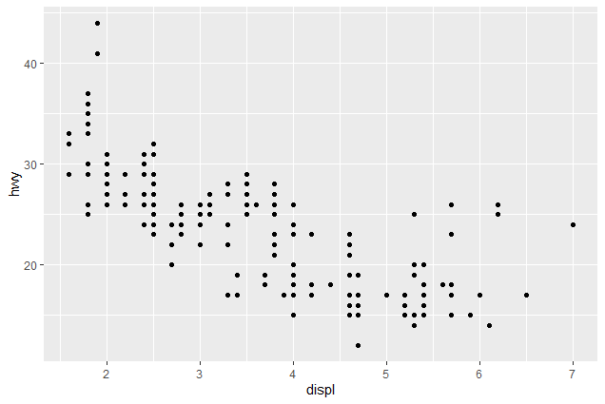
ggplot2 package
Here’s a simple example:
ggplot(mpg, aes(x = displ, y = hwy))
+ geom_point()
This produces a scatterplot defined by:
1. Data: mpg.
2. Aesthetic mapping: engine size (displ) mapped to x position, highway miles per gallon (hwy) to y position.
3. Layer: points.

Slide 10
2
Importance of Data Visualization

Slide 11
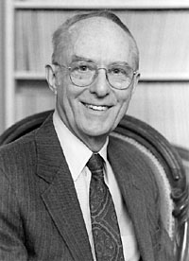
Anscombe's quartet
Frank Anscombe constructed four datasets. Each dataset consists of eleven (x,y) points. These data sets have nearly identical simple descriptive statistics.
Anscombe's quartet demonstrates both the importance of graphing data before analyzing it and the effect of outliers and other influential observations on statistical properties.
Frank Anscombe
https://en.wikipedia.org/wiki/Frank_Anscombe

Slide 12
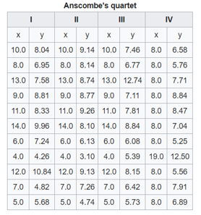
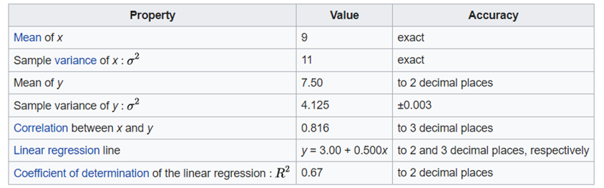
Anscombe's quartet
https://en.wikipedia.org/wiki/Anscombe%27s_quartet

Slide 13
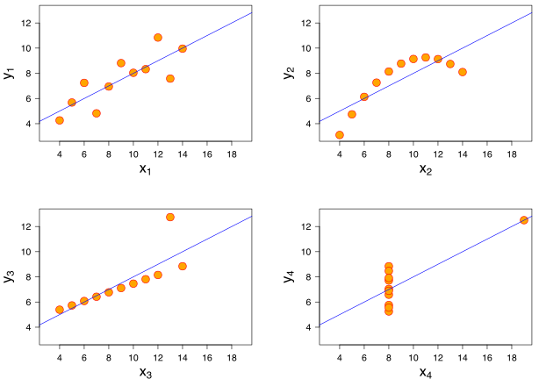
Anscombe's quartet
1
Two variables correlated and following the assumption of normality.
1
2
2
It is not distributed normally + There is non-linear relationship.
3
4
3
A perfect linear relationship, except for one outlier which lower the correlation coefficient from 1 to 0.816.
4
Clearly shows that one outlier is enough to produce a high correlation coefficient, even though the relationship between the two variables is not linear.
https://en.wikipedia.org/wiki/Anscombe%27s_quartet

Slide 14
3
Line and Path plots

Slide 15
Line and Path plots
Line and path plots are typically used for time series data.
Line plots join the points from left to right, while path plots join them in the order that they appear in the dataset.
Line plots usually have time on the x-axis, showing how a single variable has changed over time. Path plots show how two variables have simultaneously changed over time, with time encoded in the way that observations are connected.

Slide 16
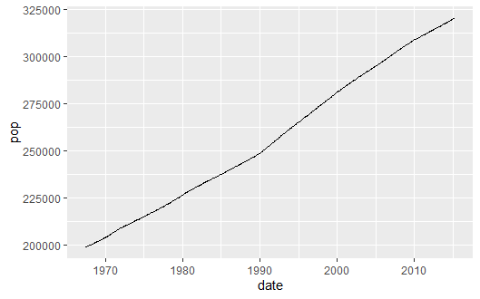
Line and Path plots
geom_line () function in the ggplot2 package is used to plot line graphs.
geom_line () function connects the observations in order of the variable on the x axis.
ggplot(economics, aes(x=date, y=pop)) +
geom_line()

Slide 17
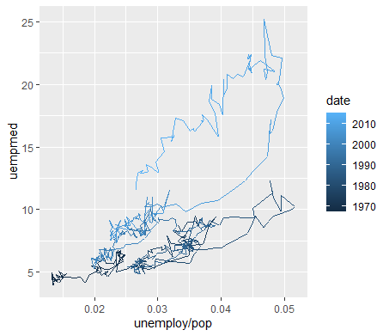
Line and Path plots
geom_path() connects observations in original order.
ggplot(economics, aes(unemploy / pop, uempmed, colour = date)) +
geom_path()

Slide 18
4
Plotting a Categorical Variable using Bar chart

Slide 19
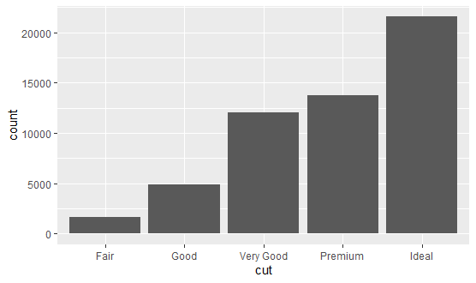
Bar chart
A bar chart shows categorical variable’s data in bars with heights proportional to that variable's values.
ggplot () with geom_bar () functions in the ggplot2 package are used to plot bar charts.
geom_bar() makes the height of the bar proportional to the number of cases in each group
ggplot(diamonds, aes(x = cut)) +
geom_bar()

Slide 20
5
Plotting a Continuous Variable using Histogram/Frequency Polygon/Boxplot

Slide 21
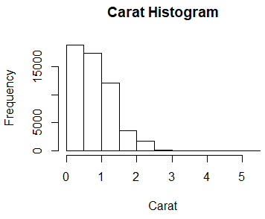
Histogram
Histogram shows the distribution of values for a variable.
Histograms break the data into buckets and the heights of the bars represent the number of observations that fall into each bucket.

Slide 22
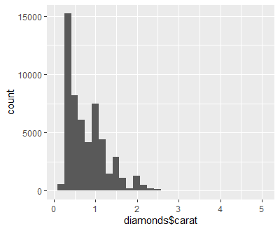
Histogram
ggplot() with geom_histogram() in the ggplot2 package are used to plot histograms.
ggplot(diamonds, aes(x=carat)) +
geom_histogram()

Slide 23
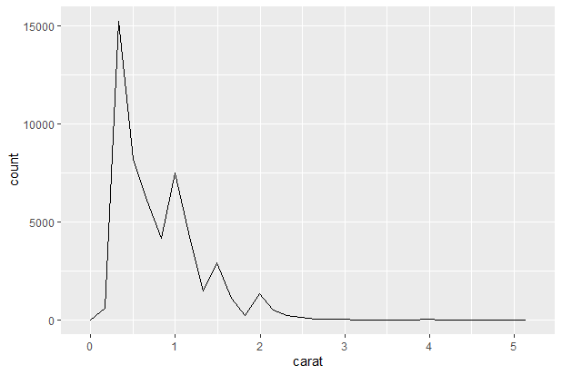
Frequency Polygon
Like Histograms, frequency polygons show the distribution of a single numeric variable.
Histograms use bars and frequency polygons use lines.
ggplot(diamonds, aes(x=carat)) +
geom_freqpoly()

Slide 24
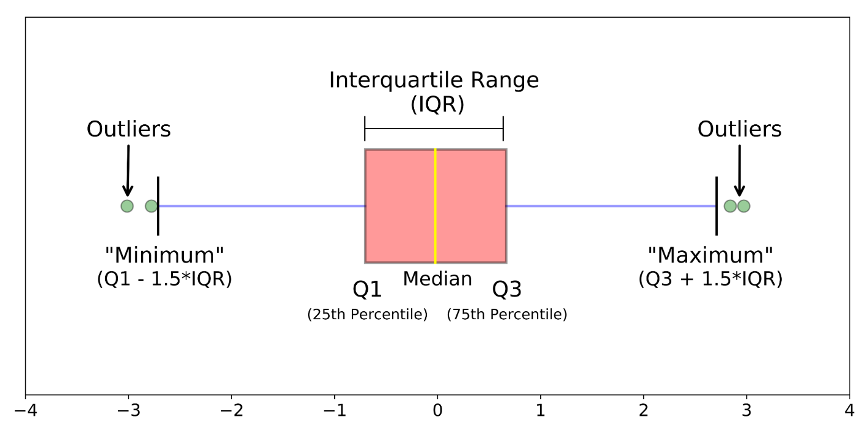
Boxplot
Boxplot depicts groups of numerical data through their quartiles.
The middle line in the boxplot represents the median and the box is bounded by the first and third quartiles.
The Interquartile Range (IQR) represents the middle 50% of data.
https://towardsdatascience.com/understanding-boxplots-5e2df7bcbd51

Slide 25
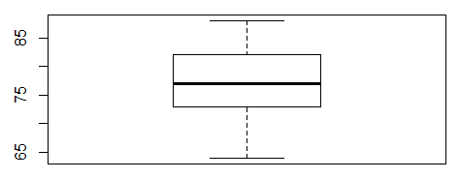
Boxplot
A series of hourly temperatures were measured throughout the day in degrees Fahrenheit.
The recorded values are listed in order as follows: 64, 64, 64, 65, 70, 73, 73, 74, 74, 75, 76, 77, 77, 77, 77, 79, 80, 82, 82, 83, 83, 85, 86, 88.
> summary(temp)
Min. 1st Qu. Median Mean 3rd Qu. Max.
64.00 73.00 77.00 76.17 82.00 88.00

Slide 26
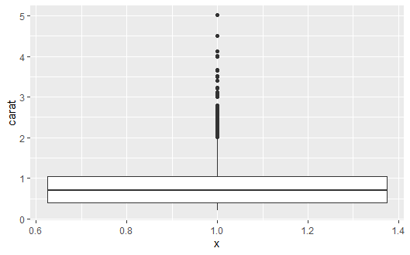
Boxplot
ggplot() with geom_boxplot() in the ggplot2 package are used to produce boxplots.
ggplot(diamonds, aes(y=carat, x=1)) +
geom_boxplot()
Even though it is one-dimensional, using only a y aesthetic, there needs to be some x aesthetic, so we will use 1.

Slide 27
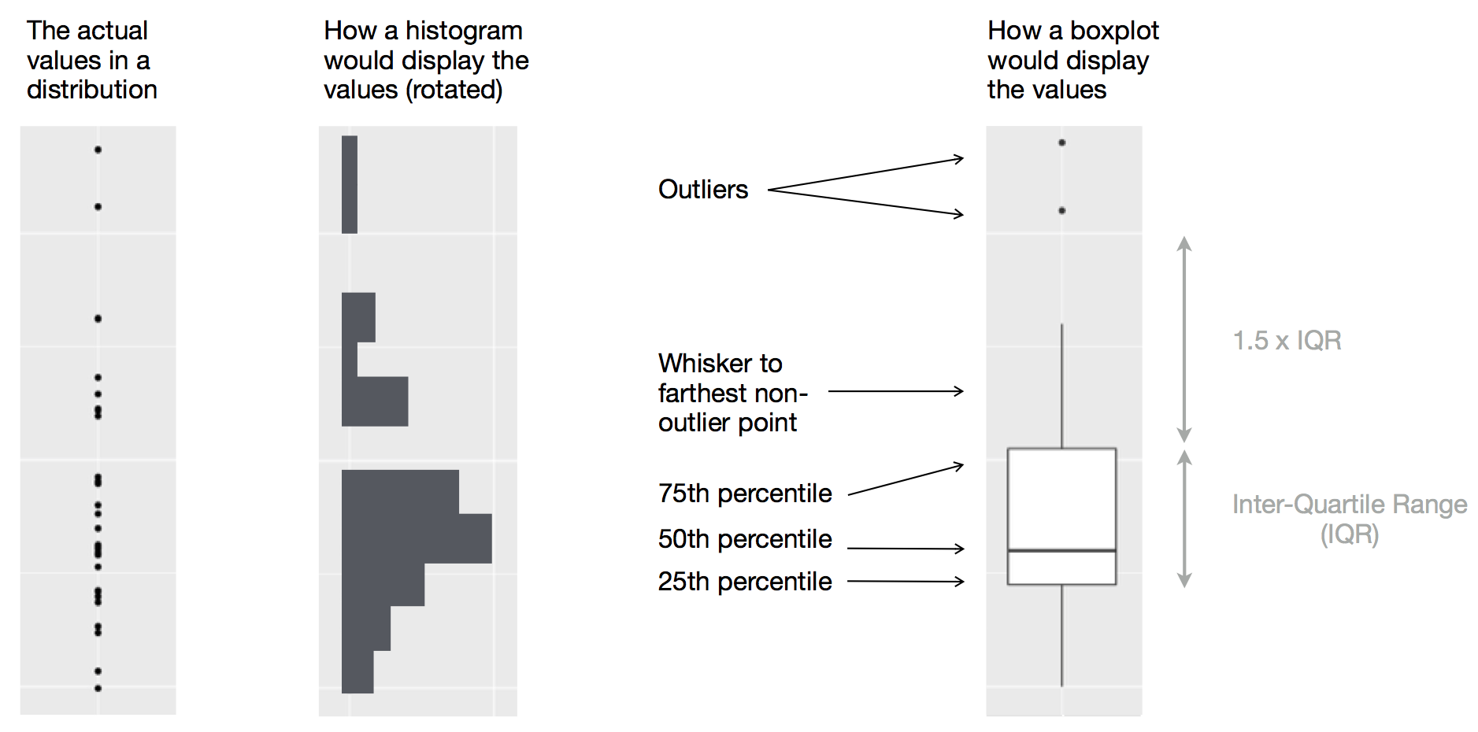
Boxplot
https://r4ds.had.co.nz/exploratory-data-analysis.html#missing-values-2

Slide 28
6
Visualize the covariation between two continuous variables using Scatterplot

Slide 29
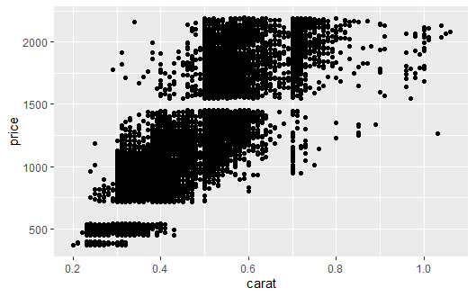
Scatterplot
Scatterplot is a diagram that is used to visualize the covariation between two continuous variables. Covariation is a correlated variation of two or more variables.
Every point represents an observation in two variables where the x-axis represents one variable and the y-axis another.

Slide 30
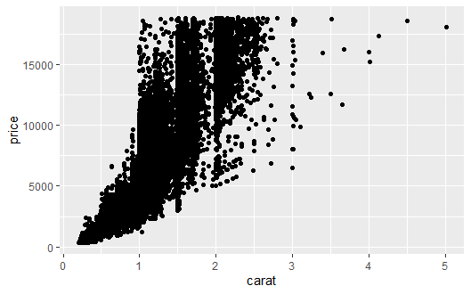
Scatterplot
ggplot() with geom_point() in the ggplot2 package are used to create scatterplots.
ggplot(diamonds, aes(x=carat, y=price)) +
geom_point()

Slide 31
7
Visualize the covariation between two categorical variables using Count plot

Slide 32
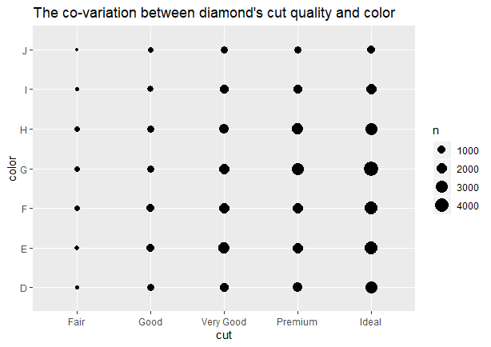
Count plot
Two categorical variables: can be explored by counting the number of observations for each combination.
ggplot(diamonds, aes(x = cut, y = color)) +
geom_count() +
labs(title="The co-variation between diamond's cut quality and color", x="cut", y="color")
N represents how many observations occurred at each combination of values.

Slide 33
8
Visualize the covariation between a categorical and continuous variables using Box plot

Slide 34
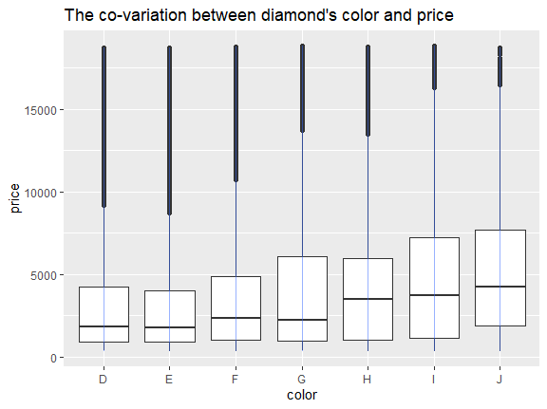
Box plot
A categorical and continuous variables: can be explored using boxplots.
ggplot(diamonds, aes(x = color, y = price)) +
geom_boxplot() +
labs(title="The co-variation between diamond's color and price", x="color", y="price")

Slide 35
9
More about plots

Slide 36
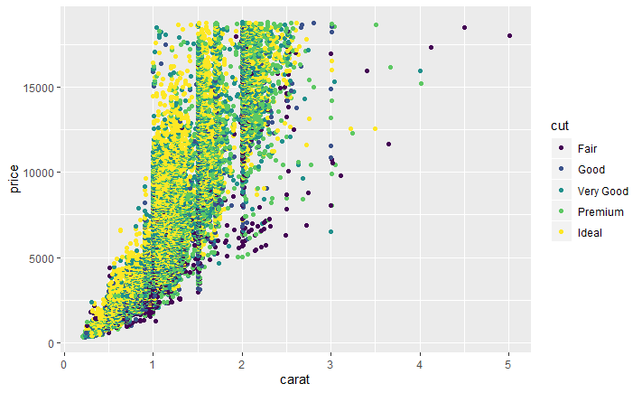
Using colors in plots
ggplot(diamonds, aes(x=carat, y=price, color=cut)) + geom_point()

Slide 37
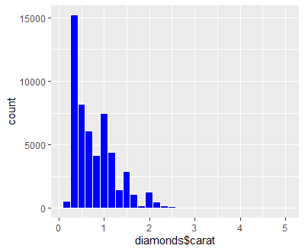
Using colors in plots
ggplot(data=diamonds, aes(x=carat)) + geom_histogram(col="white", fill="blue")

Slide 38
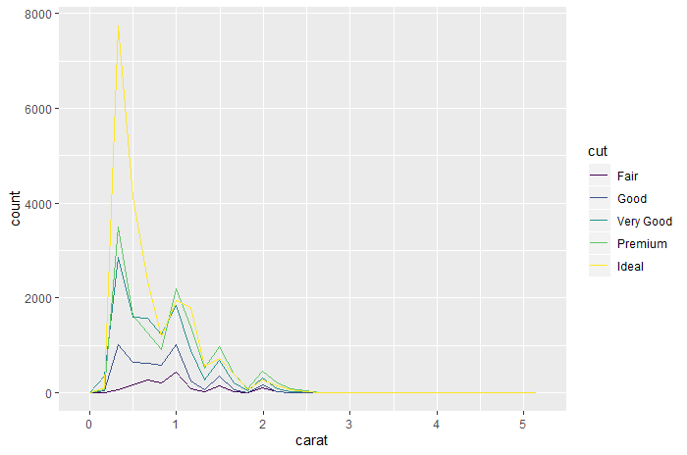
Using colors in plots
ggplot(diamonds, aes(carat, colour = cut)) +
geom_freqpoly()

Slide 39
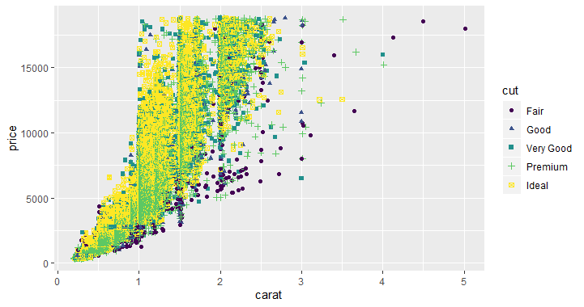
Using shapes in plots
ggplot(diamonds, aes(x=carat, y=price, color=cut , shape=cut)) +
geom_point()

Slide 40
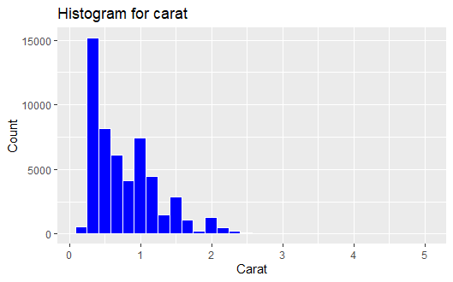
Axis and plot labels
ggplot(data=diamonds, aes(carat)) +
geom_histogram(col="white", fill="blue") +
labs(title="Histogram for carat", x=" Carat", y="Count")

Slide 41
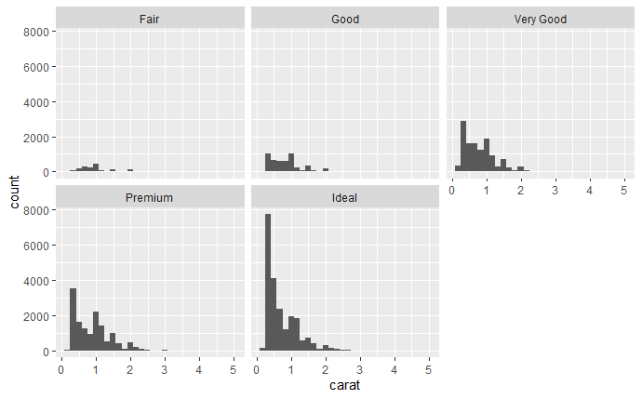
Facetting
Facetting creates tables of graphics by splitting the data into subsets and displaying the same graph for each subset.
To facet a plot you simply add a facetting specification with facet_wrap(), which takes the name of a variable preceded by ˜.
ggplot(diamonds, aes(x=carat)) +
geom_histogram() +
facet_wrap(~cut)

Slide 42
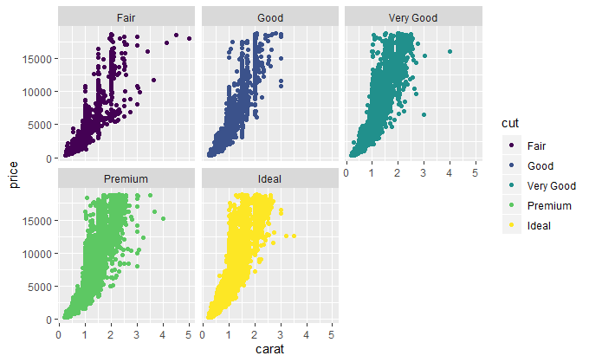
Facetting
ggplot(diamonds, aes(x=carat, y=price, color=cut)) +
geom_point() +
facet_wrap(~cut)

Slide 43
Quick Review

Slide 44
Quick Review Questions
Describe the following plots and how use them in R:
Line plot
Path plot
Bar chart
Histogram plot
Frequency polygon plot
Box plot
Scatter plot
Count plot
How to use colors and shapes in plots?
How to give axis and plots labels in R?
How to facet a plot in R?

Slide 45
Learning outcomes
Summary of Main Teaching Points
Line and path plots
Bar chart
Histogram
Frequency Polygons
Box plot
Scatter plot
Count plot
Using colors and shapes in plots
Axis and plot labels
Facetting
You should be able to use ggplot2 package for data visualization.

Slide 46
References
Garrett Grolemund & Hadley Wickham, R for Data Science, https://r4ds.had.co.nz/
Hadley Wickham, ggplot2: Elegant Graphics for Data Analysis

Slide 47
Question and Answer Session
Q & A
Book consultation slots for assistance.

Slide 48
Next Session
Data Exploration

